Slide 1

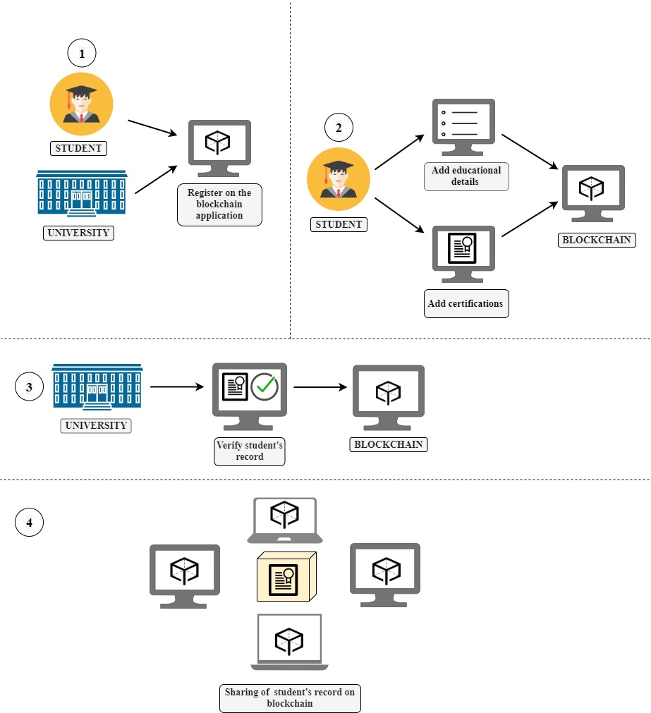

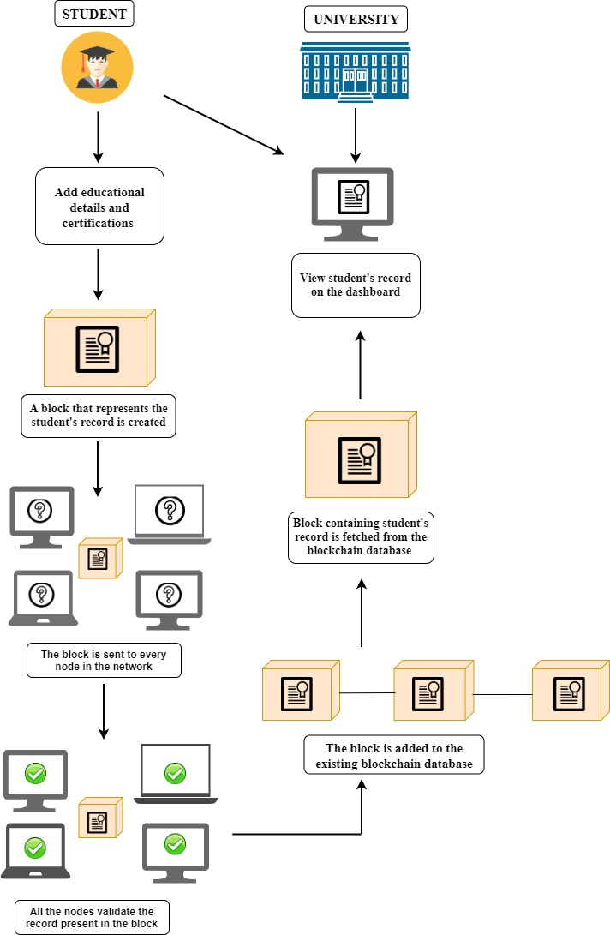







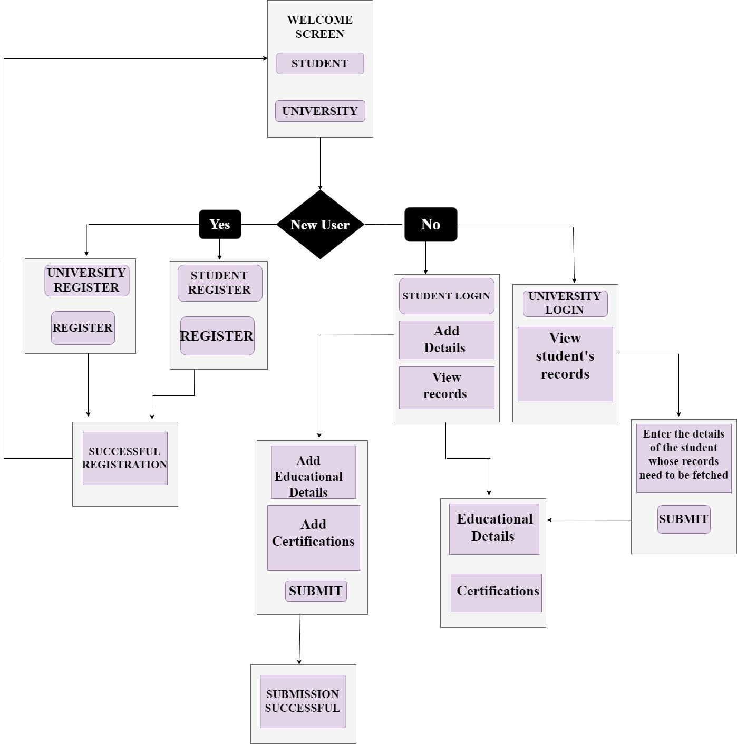

CYEBR HYGIENE TOOL
Aadhaar koul
2020a1r040@mietjammu.in
Abstract
--
The cyber hygiene tool is a security based Chrome web Extension that is designed to eliminate the haffazerd of configuring a network firewall . It is specifically designed for the day to day organisations and institutes that use multiple devices and systems . The tool uses bruteforce like algorithms that iterate through the website urls to find out specific words or key combinations to restrict the use of the particular website or topic throughout the system .
This all happens within the chrome extension and nothing is called outside the extension or the browser.
The cyber hygiene tool supports some features like sandboxing the programs and urls , learning the user activity to restrict a malicious activity on the system and an acces control list to provide specific access to the administrator and a different one to the users using the cyber hygiene tool .
The Key feature of the cyebr hygiene tool is that it uses the sandbox technology to store and ru the url ad the documets to run in the sandbox and test them there only completely isolated from the host computer .
The user can control what to downlaod and what not to after a successful check from he sandbox .
The sandbox for the extension is configured in such a way to block large downloads and only allow data that falls under a specific category .
Entity Relationship Diagram / Data Processing workflow
User / Admin Browser
Sandbox
Environment
Hygiene Tool enabled
Isolated Execution
File Analyser
Innovation & Impact
Request Analyser and Parser
Innovation
Uses a Sandbox to test urls and files for malicious content
Blocks urls that might lead to a dark web portal
Impact
Eliminating the need to configure firewalls .
Implementig the Security statically (offline) .
Predicting the user activity and blocking the possible malicious content
Url Requests
Block Adult Sites
Block Music Sites
Block Torrent Sites
Block Large Downloads
Run Programs and downloads in a sandboxed environments
Block links leading to Dark Web Portals
Requests
Protocols
Use Cases | Functional Workflow
Architecture Diagram
Administrator
User
Parser
Cyber Hygiene Tool
(Offline)
User
Internet
Access
Internet
Sandboxing the
System
Cyber Hygiene Tool
(Offline)
Priviliged URL Access
Administration
Running Programs Virtually
Download Requests
Virtual Execution
Allow Safe Downloads
Sandboxing the
System
Checkig for safe Downloads
Sandboxed Containers Can be Downloaded to the Host System
Download Safe Files
Screen Flow | Interaction Model
User
Administrator
Downloadig Safe Files
Language(s) | API(s) | Technology Stack
Sandboxed
Environment
Url
Checking
Sandboxed
Environment
Priviliged
Url
Access
Languages used: HTML, CSS, JavaScript , Jquery
Tools used: Google API , Chrome Browser , Sandboie
Technology: RPA , Sandbox
Internet
Access
Checking for Malicious
Contents
Liberty to
Access Private site / addresses
Access To Internet
Internet
Access

